Slide 1
Tourism Recommendation Application
Guide: Ruchi Sawhney By: Ankit Alex Minz
Dibya Bharat Khatua

Slide 2
Objective and Scope
Objective
Create a Tourism Recommendation App.
Collect user information about their vacation preferences.
Provide a customized travel plan.
Include details such as hotel pricing, travel costs, travel routes, etc.
Offer live reporting on traffic and current pricing.
Scope
Develop and implement recommendation algorithms.
Tailor plans and services based on user details and interests.
Include recommendations for pricing, travel, hotels, eateries, and other necessities.
Provide live location services for nearby necessities during the user's travel.

Slide 3
Problem Statement
Problem:
Traditional tourism apps provide fixed plans with set schedules.
Travelers have limited control over their itinerary.
Need for an app that allows flexible, self-guided travel.
App should recommend landmarks, general pricing of amenities, etc.
Background:
Some travelers prefer planning their vacations independently.
Requires detailed research for safe and satisfying travel.
Information is scattered across the internet or requires local communication.
Need for a centralized source of live and regularly updated travel information.
Relevance:
Keeps users informed about various aspects of self-guided travel.
Provides updated information on hotel and travel pricing.
Offers live traffic updates for planned travel routes.
Eliminates the need for assistance from tourism agencies.

Slide 4
Hardware & Software Requirements
Hardware Requirements:
Windows 10 or above
RAM: 16 or above
Processor: Intel core i5 5th Gen or above
Android device: 4GB Ram, Version: 11+

Slide 5
Software Requirements:
Android Studio
Java
Python
Jupyter Notebook
Android Virtual Device or Emulator
XML for UI
Firebase
Version Control System (Git)
Machine learning with TensorFlow

Slide 6
System Analysis & Design
Iterative Waterfall Model Overview
Combines sequential steps of the traditional Waterfall Model with iterative design flexibility.
Allows improvements and changes at each development stage.
Provides feedback paths from each phase to preceding phases, unlike the classical waterfall model.
Error Detection and Correction
Feedback paths enable correction of errors in the phase where they were committed.
Changes are reflected in subsequent phases.
No feedback path to the feasibility study stage since projects are not easily abandoned.
Benefits
Detecting and correcting errors within the same phase reduces effort and time required.

Slide 7
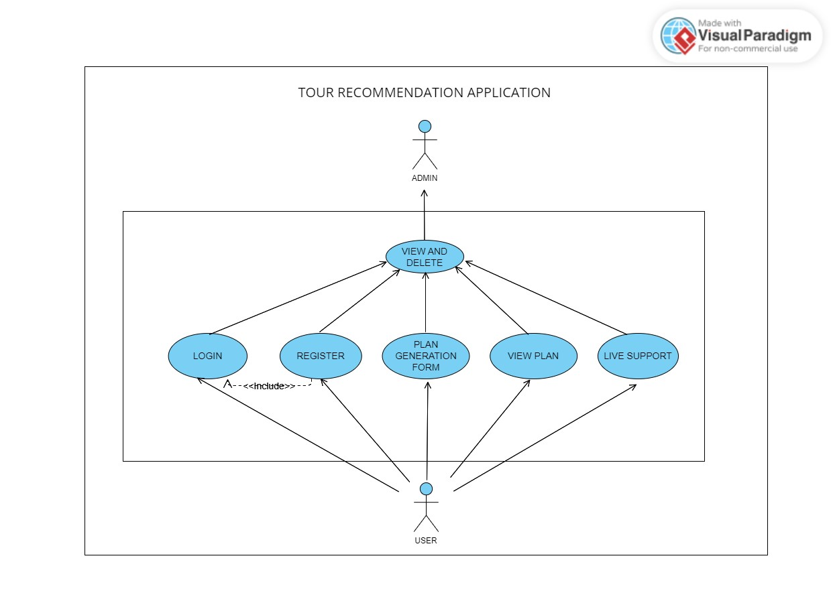
Use Case Diagram

Slide 8
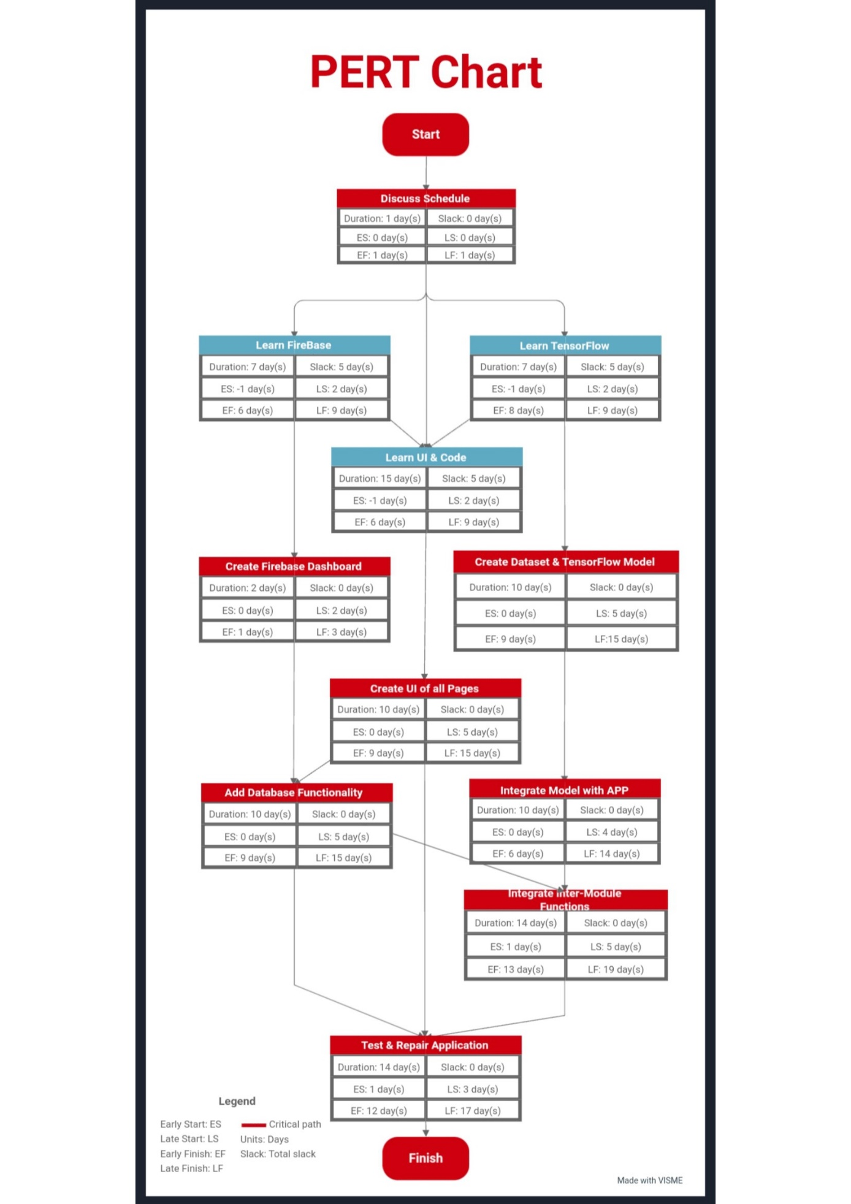
Pert Chart

Slide 9
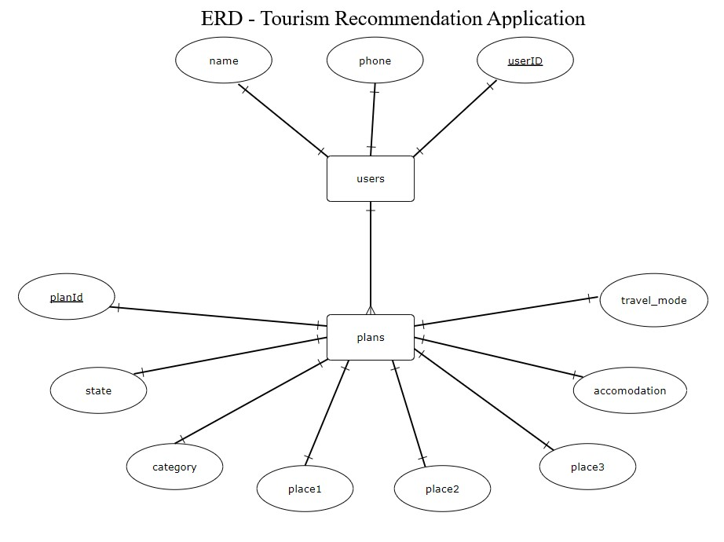
Entity Relationship Diagram

Slide 10
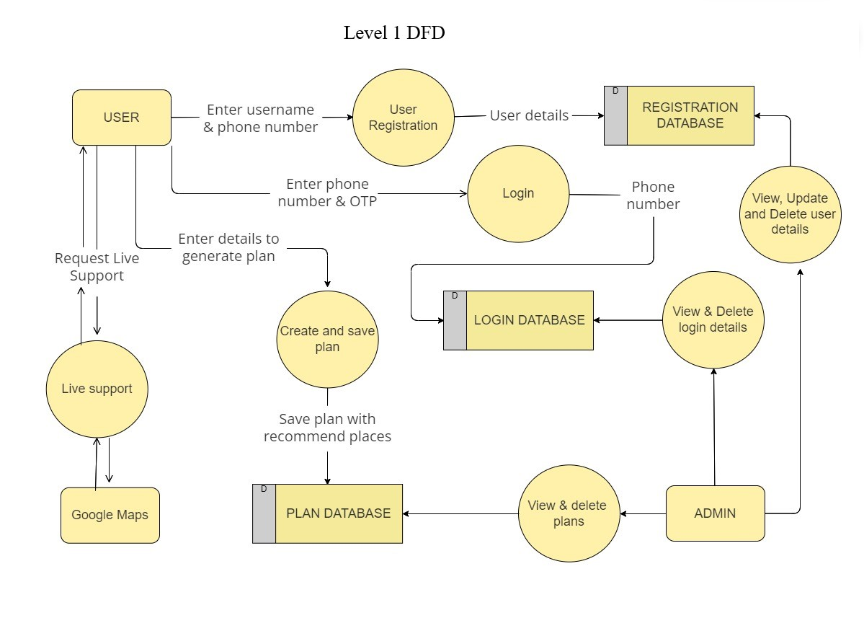
Data Flow Diagram

Slide 11
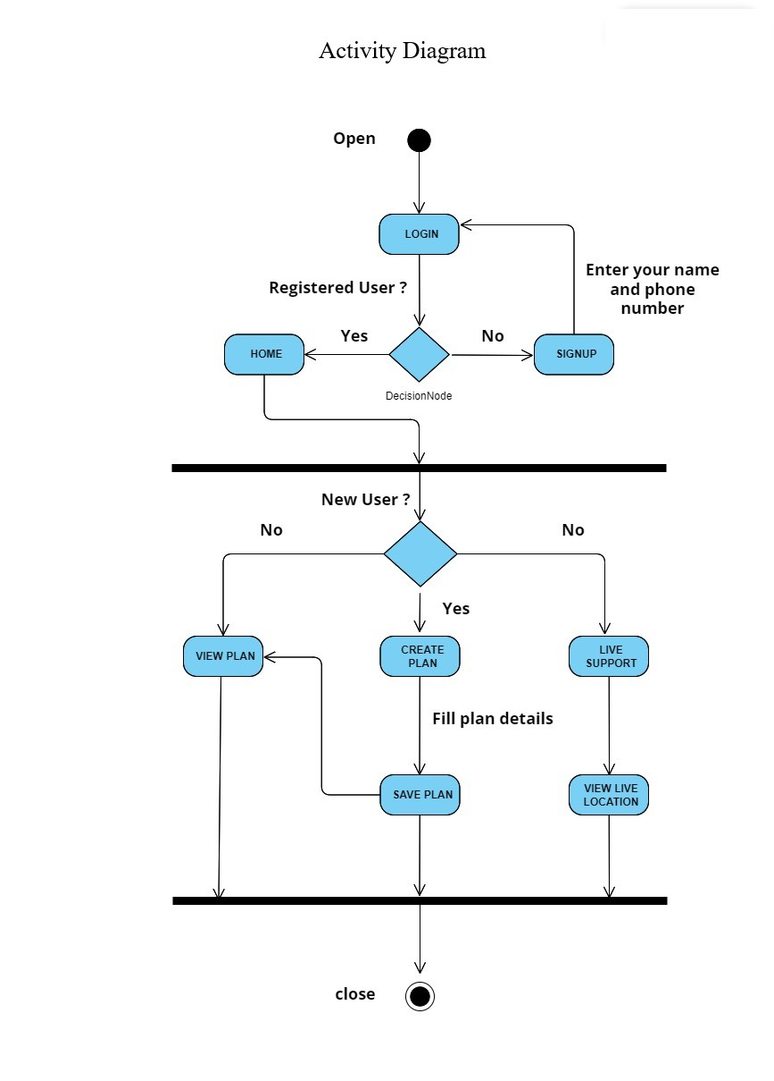
Activity Diagram

Slide 12
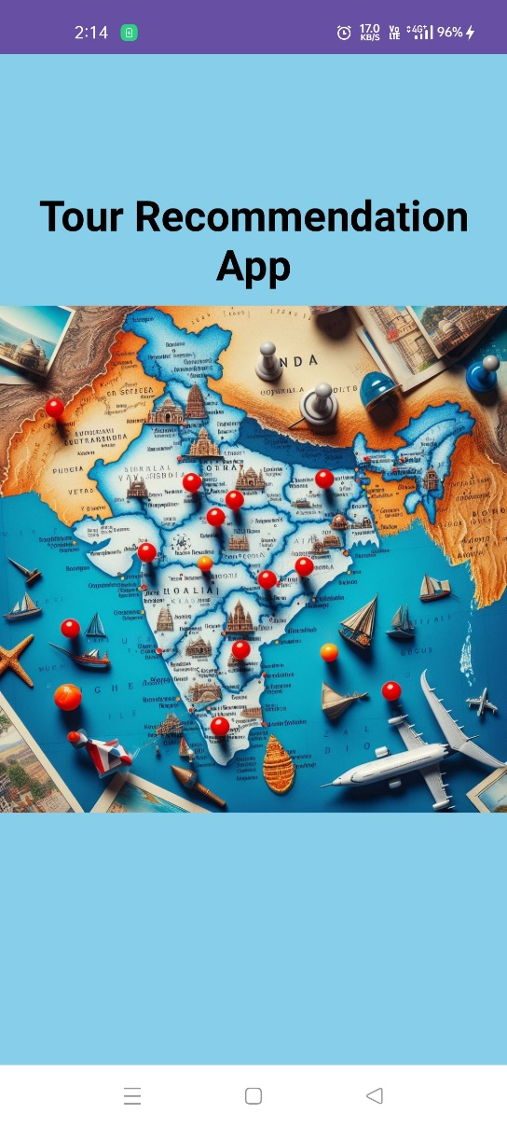
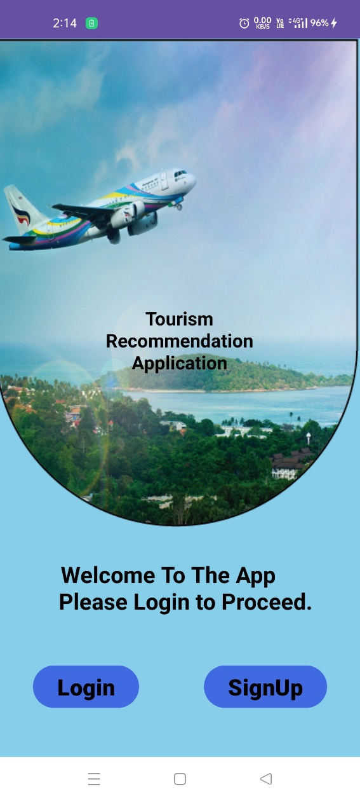
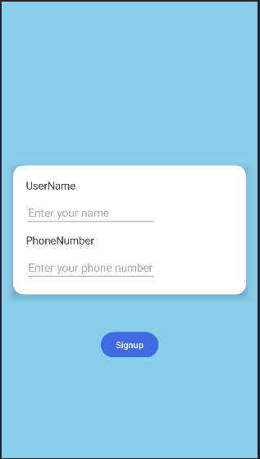
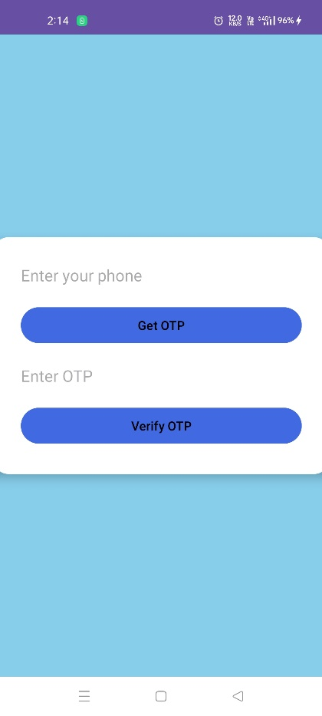
Application User interface

Slide 13
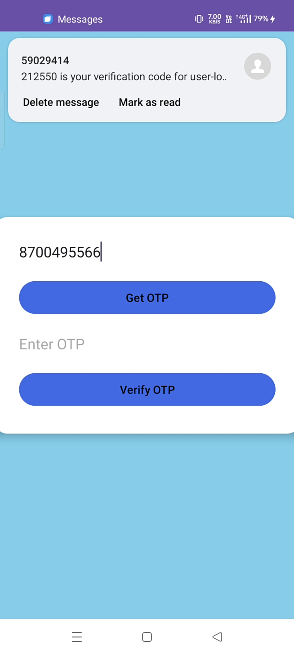
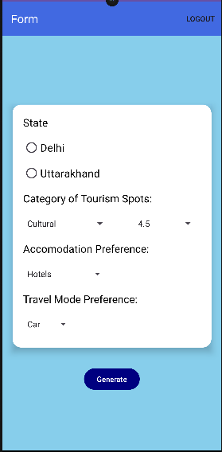
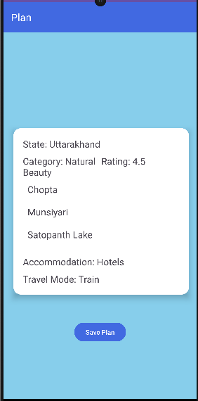
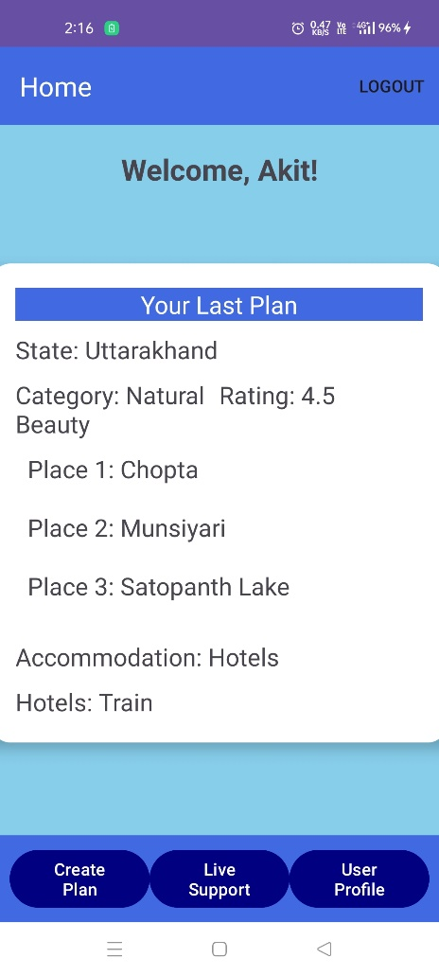
98387163XX

Slide 14
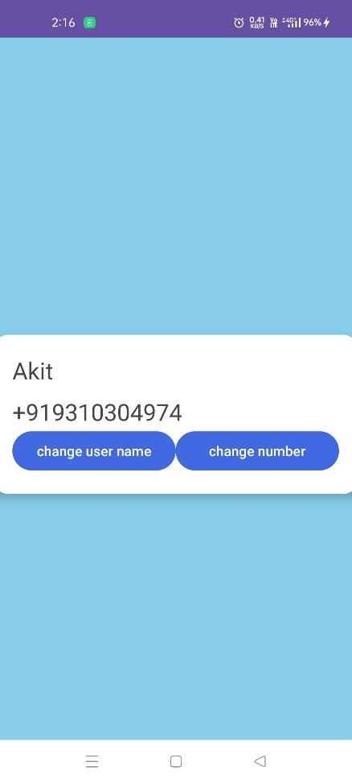
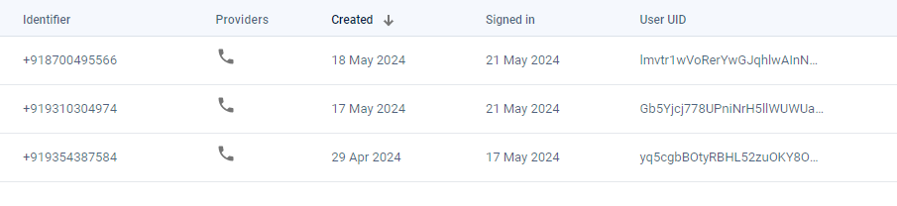
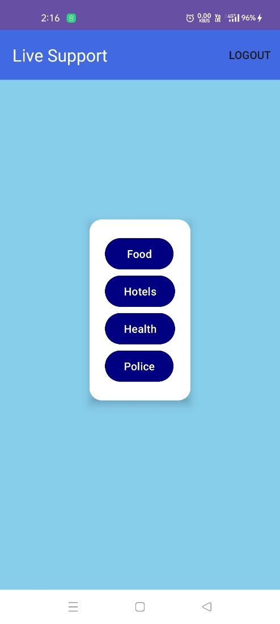
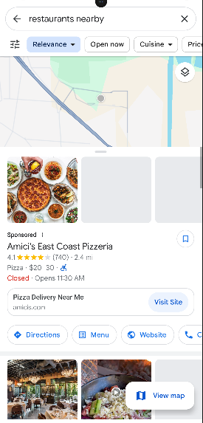
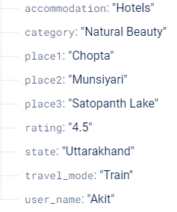

Slide 16
Conclusion and future scope
Allows users to navigate the traveling process independently.
Provides recommendations for great places to visit.
Offers routes for travel.
Includes live support for user navigation during travels.
Future Scope:
Upgrade the machine learning model.
Add a collaborative model to enhance output refinement.
Integrate additional functions to centralize all travel-related information within the app.
Aim to cover all aspects of traveling and touring within the application.

